Slide 2
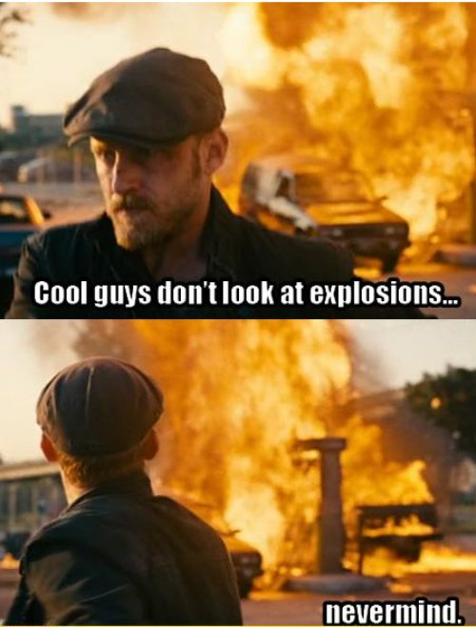
Source: Andhika 2011

Slide 3
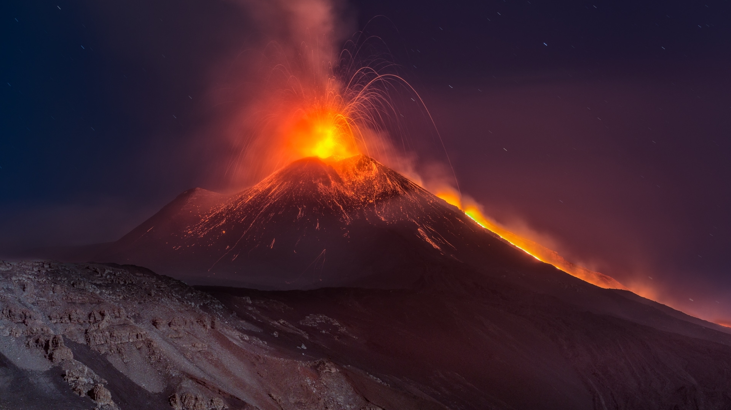
A Risk Analysis for the Etna Region Using Free and Open Source GIS
Johannes Nützel, Sebastian Ulmeanu, Tim Waibel

Slide 4
Content
Mt. Etna and its surroundings
Motivation
Workflow
Data
Tools
Vulnerability analysis
Q-Lavha
What‘s next?
A Risk Analysis for the Etna Region Using Free and Open Source GIS

Slide 5
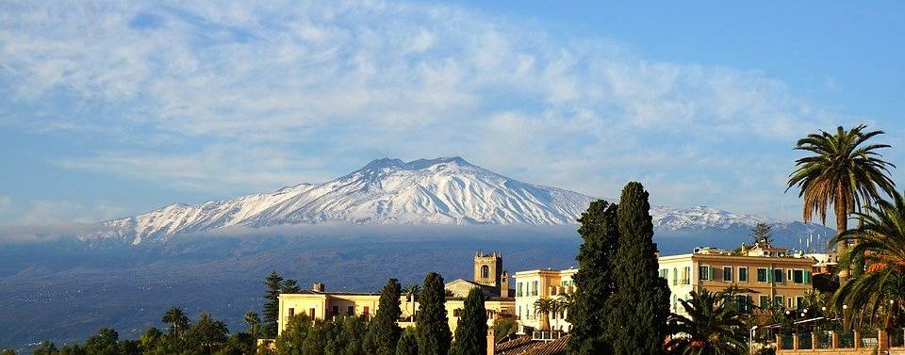
1. Mt. Etna and its Surroundings
Fig.1 Mt. Etna (Pixabay 2017)
Some kind of text…
Notes:
Facts
History
Current status
Area

Slide 6
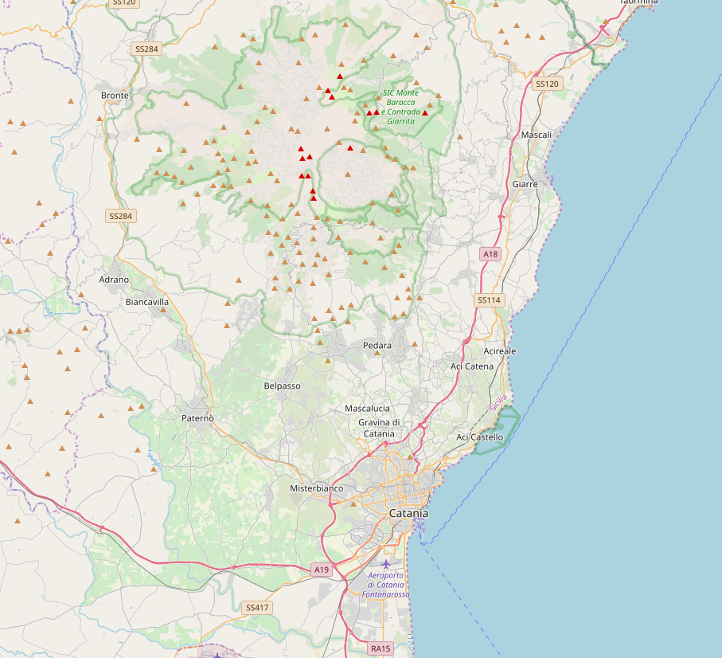
Radius | Population
5km | 78
10km | 3,291
30km | 1,016,540
100km | 3,052,770
Source: https://volcano.si.edu/ volcano.cfm?vn=211060
Fig.2 Surroundings of Mt. Etna (OpenStreetMap 2020)
Some kind of text…

Slide 7
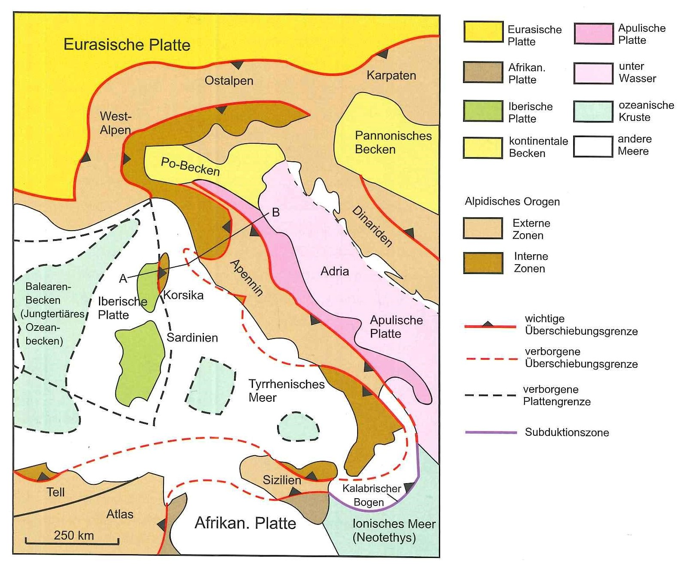
Geology
Fig.3 Geology of Italy (Park 2015)
A Risk Analysis for the Etna Region Using Free and Open Source GIS

Slide 8

2. Motivation
Can we do it without professional software?
Can it be done without a numerical model?
A Risk Analysis for the Etna Region Using Free and Open Source GIS
Notes:
Why
How - workflow
What - results

Slide 9
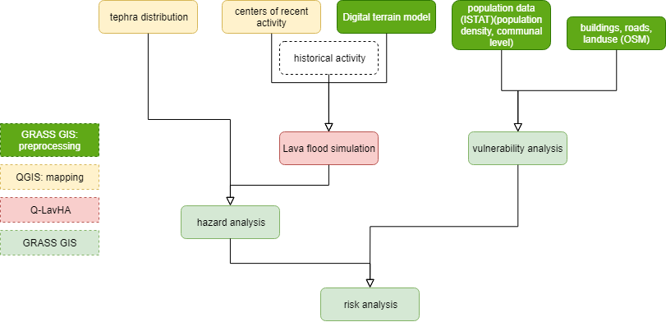
3. Workflow
A Risk Analysis for the Etna Region Using Free and Open Source GIS
Notes:
Why
How - workflow
What - results

Slide 10
4. Data
on hazards:
DTM and historical data of previous eruptions
on vulnerability
Population data
Administrative areas
Buildings
Streets
Landuse
A Risk Analysis for the Etna Region Using Free and Open Source GIS
Notes:
Population data: ISTAT = governmental data from census 2011 – can be downloaded e.g. just for Sicily and contains data for population, density sorted by postal codes
DTM from opendataportal (resolution 20m) as geotiff

Slide 11
5. Tools
Overpass Turbo for data collection
GRASS GIS for vulnerability analysis
QGIS for mapping
Q-LavHA for lava flood simulation (QGIS plugin)
A Risk Analysis for the Etna Region Using Free and Open Source GIS
Notes:
GRASS GIS: Import, clip, rasterize, map calculation for vulnerability; v.db.droprow, dropcolumn (database operations) for preprocessing of population data and merging with geographical data (administrative regions)

Slide 12
Overview: Workflow
A Risk Analysis for the Etna Region Using Free and Open Source GIS

Slide 13
6. Vulnerability Analysis
Building density
Number of buildings per 100x100m
Landuse
Different landuse purposes reclassified
Population density
Density of population per district
Road density
„Roadpoints“ of relevant roads per 100x100m
High vulnerability
Low vulnerability
A Risk Analysis for the Etna Region Using Free and Open Source GIS

Slide 14
Weighting
A Risk Analysis for the Etna Region Using Free and Open Source GIS

Slide 15
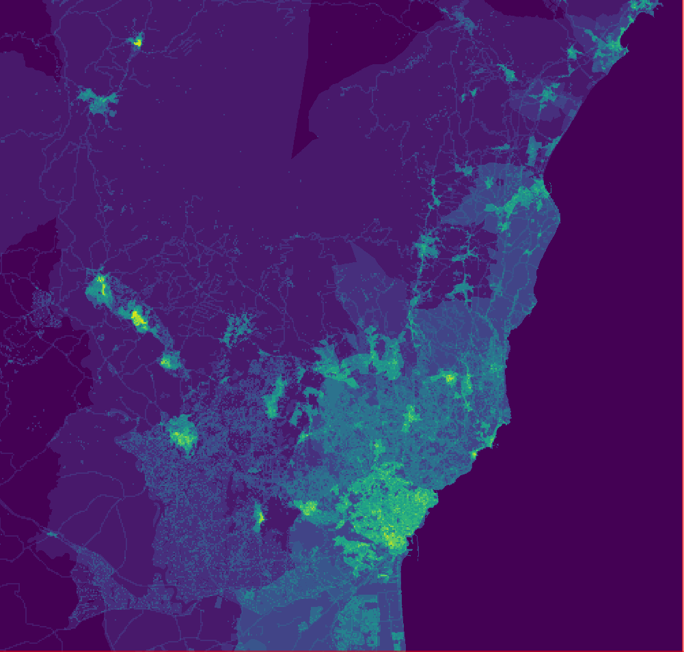
High vulnerability
Low vulnerability
Some kind of text…

Slide 16
Overview: Workflow
A Risk Analysis for the Etna Region Using Free and Open Source GIS

Slide 17
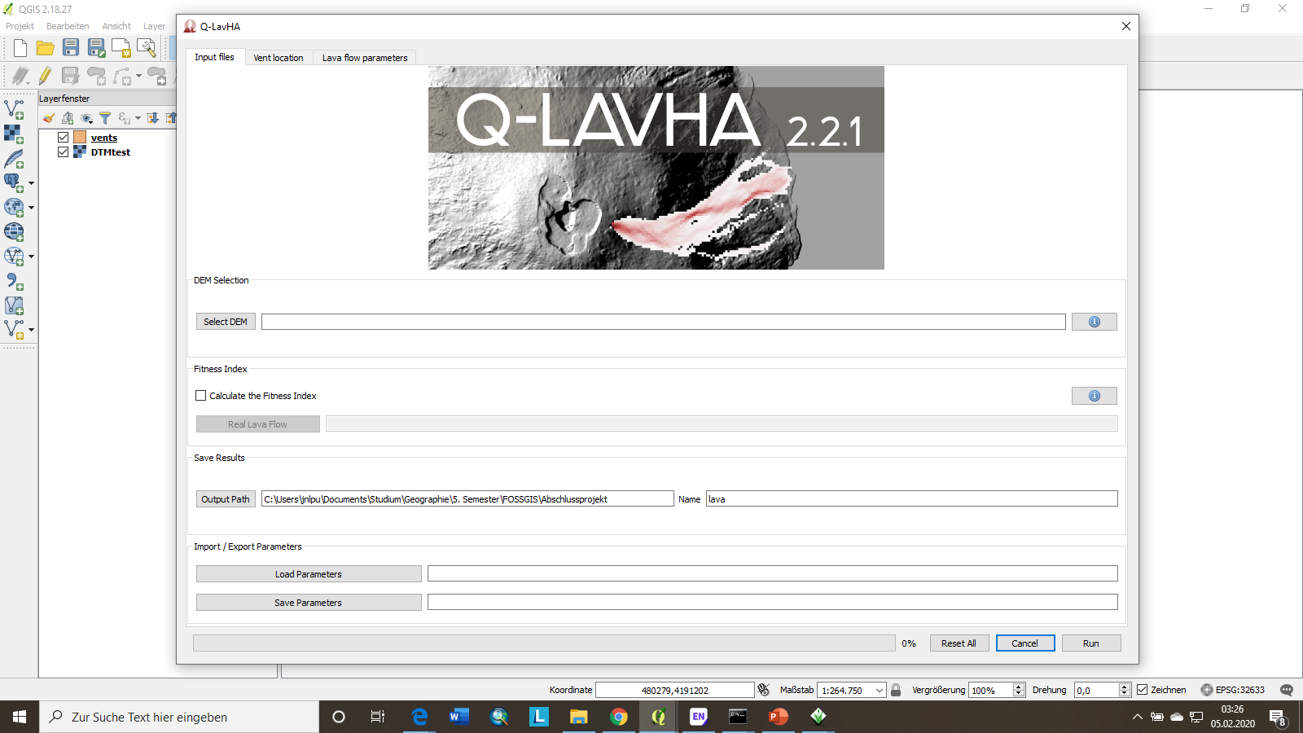
7. Q-LavHA
Fig.4 Q-Lavha Interface

Slide 18
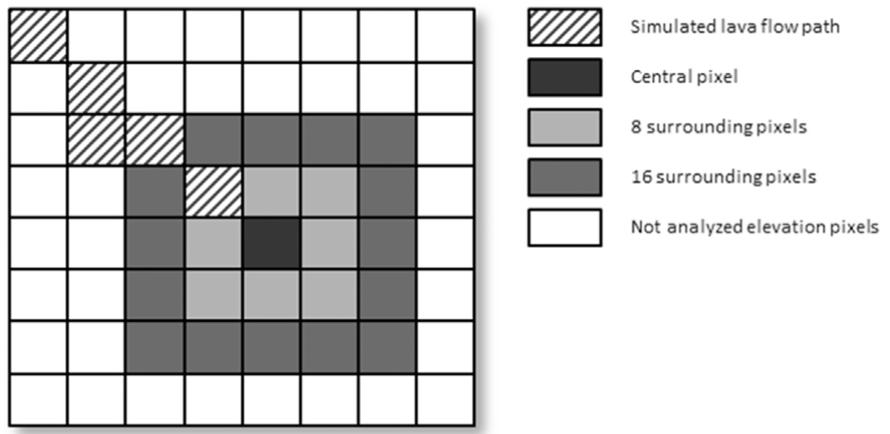
Lava Flow Path
Fig.5 The central pixel and its surroundings pixels. (Mossoux et al. 2016, p.99)

Slide 19
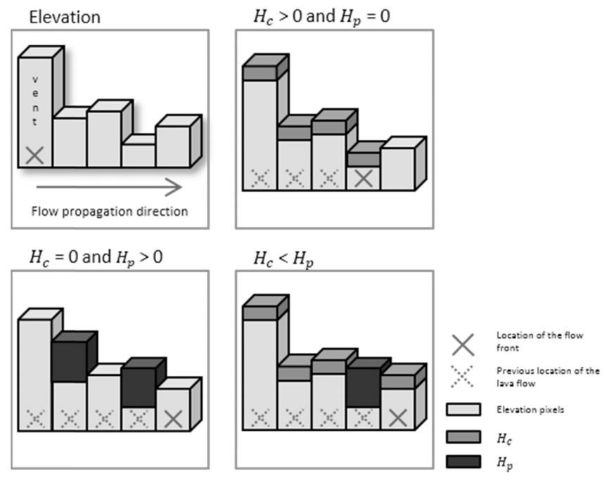
Corrective Factors
Fig.6 Use of the corrective factors H_{c} and H_{p} on the elevation pixels (Mossoux et al. 2016, p.100)

Slide 20
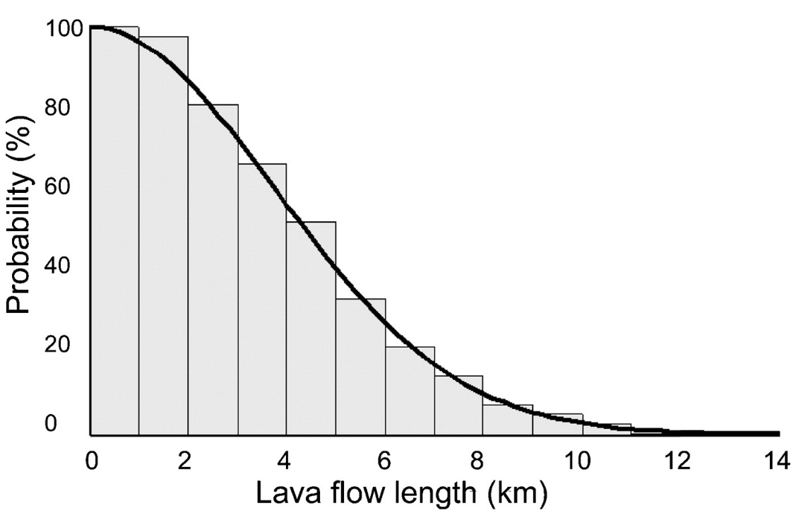
Options for Lava Flow Length
Maximum length
Decreasing cumulative density function
FLOWGOW cooling-limited
Fig.7 Decreasing cumulative density function (Bonne et al. 2008).
A Risk Analysis for the Etna Region Using Free and Open Source GIS

Slide 21
Current Results
Traceback (most recent call last):
File "C:/Users/jnlpu/.qgis2/python/plugins\volcano_plugin_v2_2_1\ui.py", line 92, in startSimulation
dem = self.loadDem()
File "C:/Users/jnlpu/.qgis2/python/plugins\volcano_plugin_v2_2_1\ui.py", line 142, in loadDem
return self.loadAscFile(path, 'DEM')
File "C:/Users/jnlpu/.qgis2/python/plugins\volcano_plugin_v2_2_1\ui.py", line 736, in loadAscFile
return simulation.raster.Raster.fromAsc(path)
File "C:/Users/jnlpu/.qgis2/python/plugins\volcano_plugin_v2_2_1\simulation\raster.py", line 47, in fromAsc
matrix = np.loadtxt(file)
File "C:\PROGRA~1\QGIS2~1.18\apps\Python27\lib\site-packages\numpy\lib\npyio.py", line 985, in loadtxt
items = [conv(val) for (conv, val) in zip(converters, vals)]
File "C:\PROGRA~1\QGIS2~1.18\apps\Python27\lib\site-packages\numpy\lib\npyio.py", line 687, in floatconv
return float(x)
ValueError: invalid literal for float(): -nan(ind)
A Risk Analysis for the Etna Region Using Free and Open Source GIS

Slide 22
8. What‘s next?
Solving the Q-LavHa error
Replacing the 20m DTM by preferably a 2m DTM, at least a 10m DEM
Calculating the Fitness Index of the model
Merging the vulnerability and hazard analysis
A Risk Analysis for the Etna Region Using Free and Open Source GIS

Slide 23
Overview: Workflow
A Risk Analysis for the Etna Region Using Free and Open Source GIS

Slide 24
Github
https://github.com/timmmerlan/fossgis_project
A Risk Analysis for the Etna Region Using Free and Open Source GIS

Slide 25
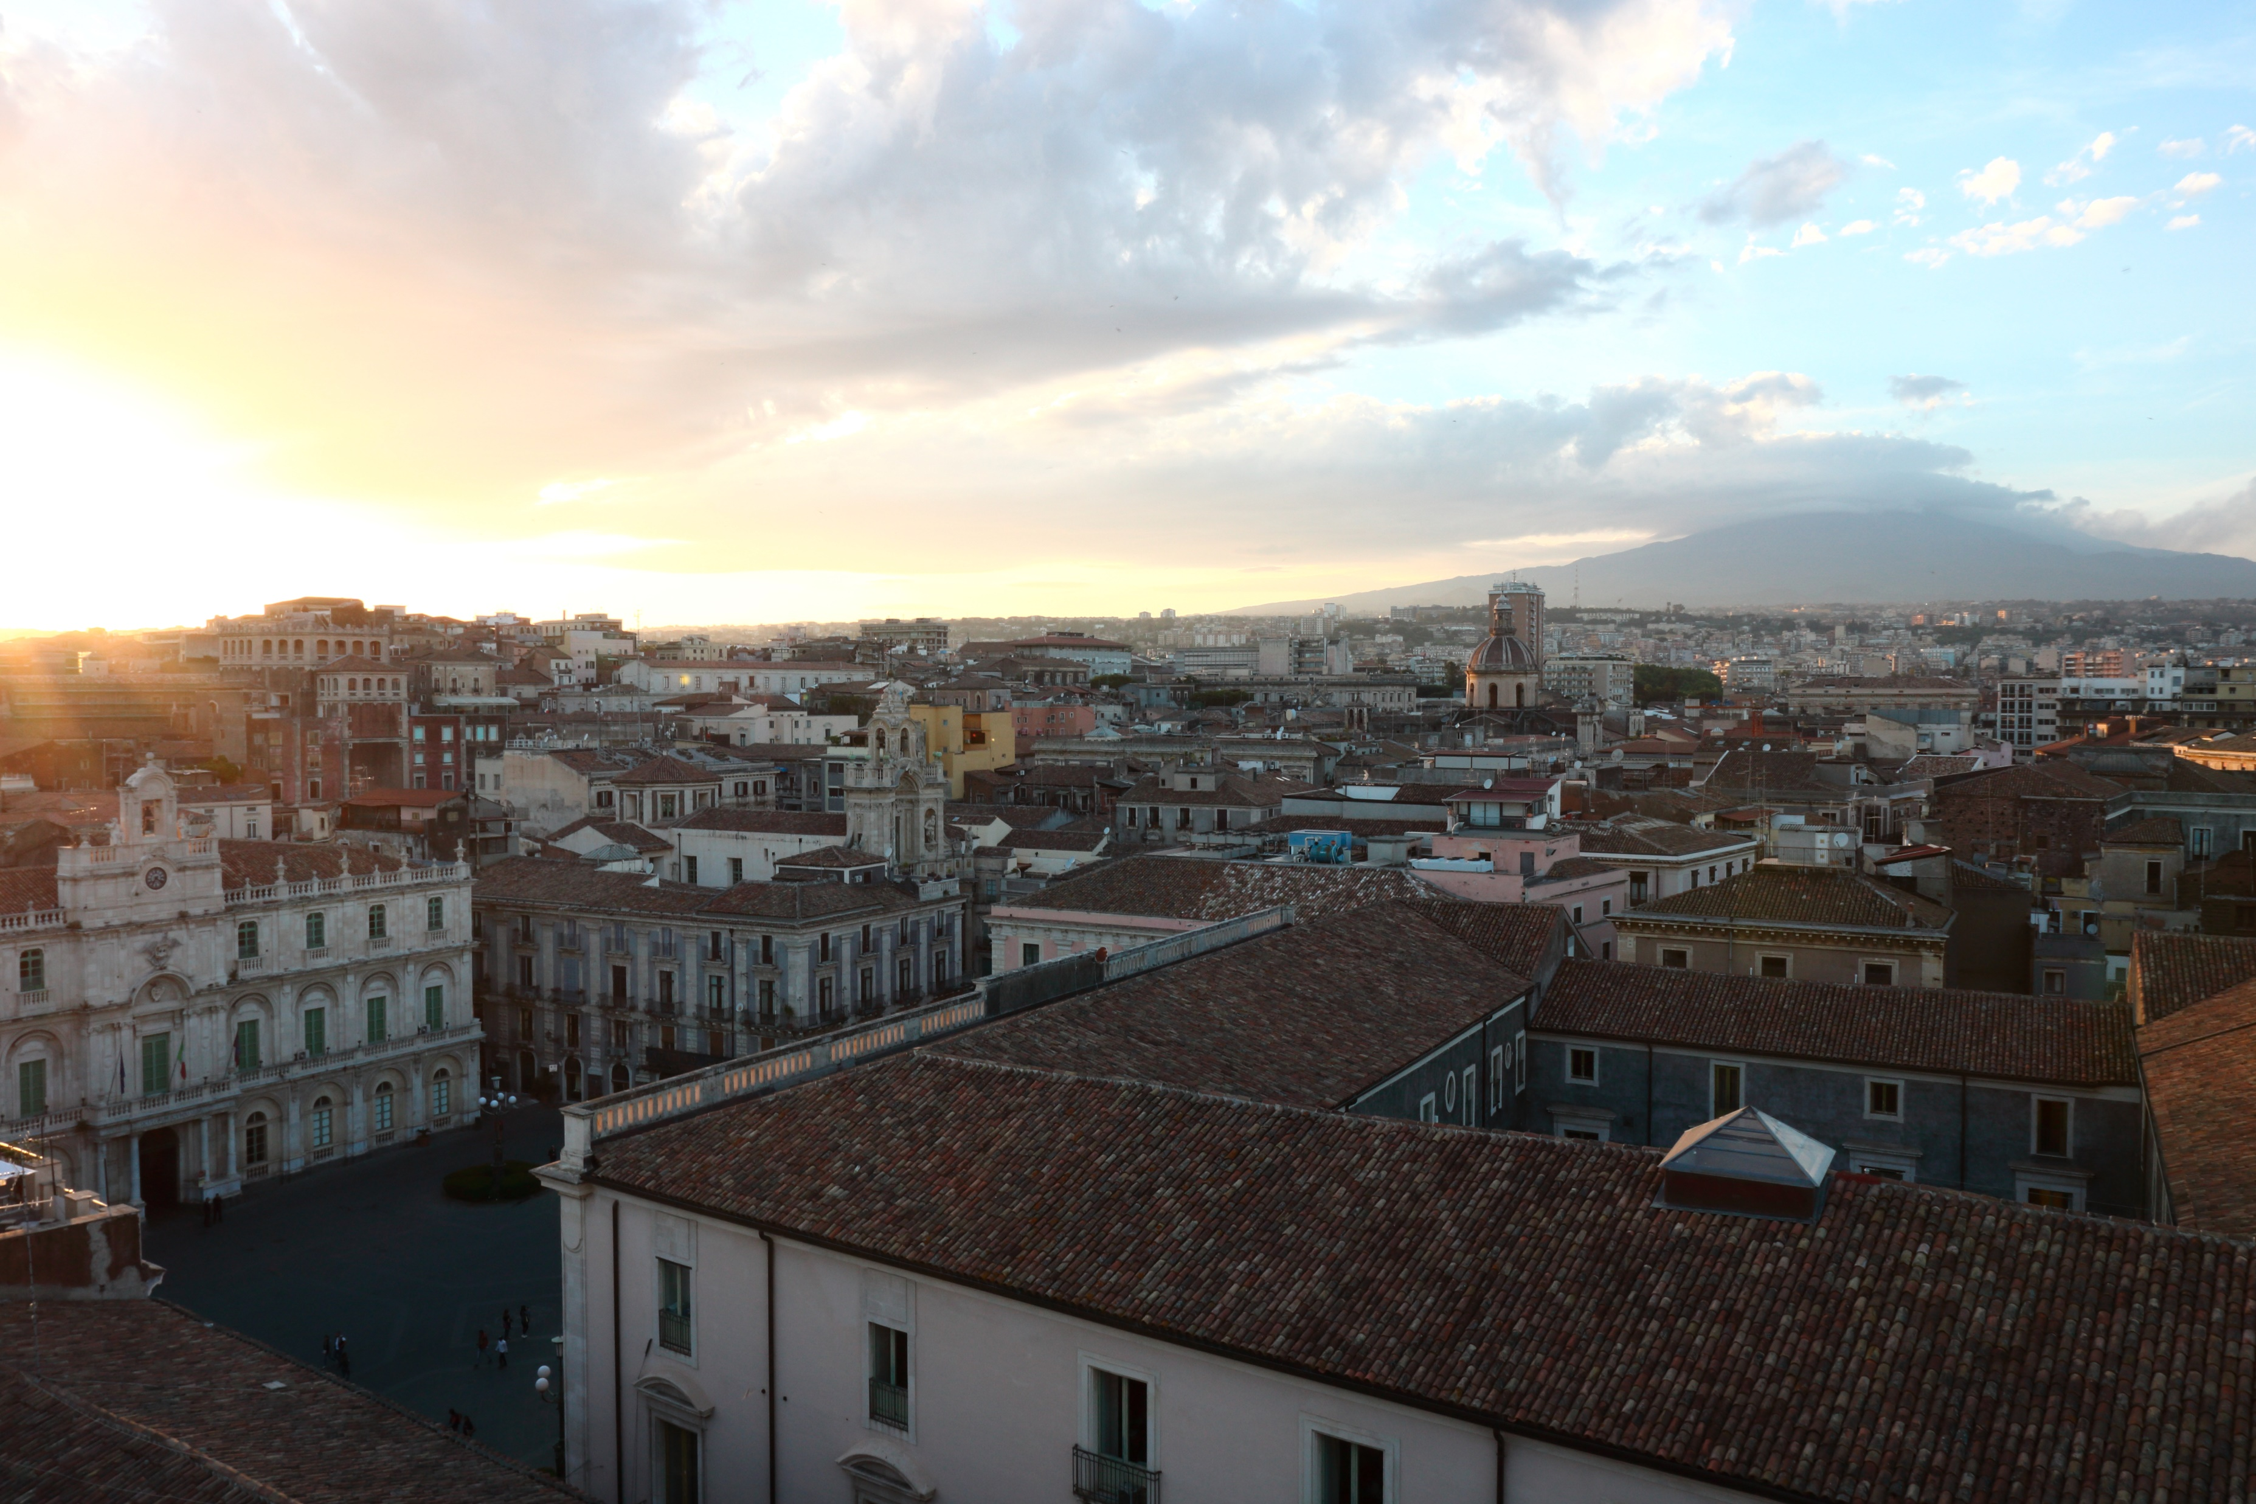
Thank You For Your Participation!

Slide 26
References
Andhika (2011): Just for fun pic. Retrieved from http://picforfuns.blogspot.com/2011/05/cool-guys-don-look-at-explosions.html (05.02.2020)
Bonne, K., Kervyn, M., Cascone, L., Njome, S., Van Ranst, E., Suh, E., Ayonghe, S., Jacobs, P., & Ernst, G. (2008): A new approach to assess long‐term lava flow hazard and risk using GIS and low‐cost remote sensing: The case of Mount Cameroon, West Africa. In: International Journal of Remote Sensing, 29(22), 6539-6564.
Mossoux, S., Saey, M., Bartolini, S., Poppe, S., Canters, F., & Kervyn, M. (2016): Q-LAVHA: A flexible GIS plugin to simulate lava flows. In: Computers & Geosciences, 97, 98-109.
OpenStreetMap (2020): OpenStreetMap. Retrieved from www.openstreetmap.org (05.02.2020)
Park, G. (2015): Die Geologie Europas. Darmstadt: WBG.
Pixabay (2017): Fotos. Retrieved from https://pixabay.com/de/photos/%C3%A4tna-vulkan-sizilien-italien-2979915/ (05.02.2020)
A Risk Analysis for the Etna Region Using Free and Open Source GIS

